Slide 1

Contact Information
Conclusion
Video 9.2

Slide 2
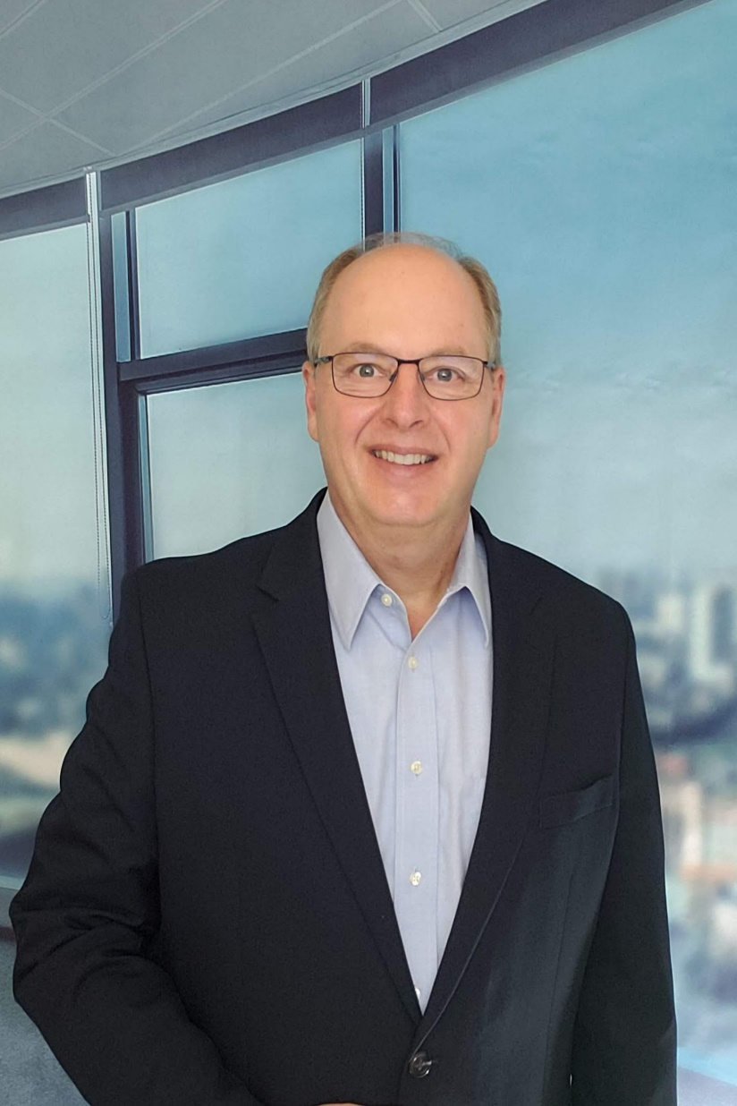
Contact Information
Brian C Newman Telecommunications Leader and 5G Advocate
How to Reach Me:
LinkedIn: www.linkedin.com/in/briancnewman
Twitter: @briancnewman
Email: Brian.C.Newman@gmail.com

Slide 3
Thank You!

